Slide 1
Methodology & IT Audit Best Practices

Slide 2
Methodology Best Practices
Kickoff Deck
Use Core Template – with updates
Executive Summary & Scope Objective Slides – a must
Timeline Slide
Due Date Terminology
Reports
Distribution List
Due Dates

Slide 3



Audit Timeline
Kick-off and information gathering
Week 1
Information gathering, identification of relevant stakeholders
August 2nd
Kick-off call
Reporting
Weeks 5 – 6
Finalization of observations, and stakeholder alignment
Preliminary report, exit meetings
September 10th
Issuance of final report
Planning and scoping
Preparation for kick-off
Hold planning meetings and draft initial scope and approach
Field-work and walk-throughs
Weeks 2 – 5
Conduct process and controls walk-throughs, interviews, and initial analysis
Notes:
Introducing Audit Timeline Visual Display

Slide 4
Standard Terminology Ratings & Management Action Plan
The rating of findings drives the timing of remediation and also the level of management that is responsible for developing and implementing action plans.
High | The identified risk requires the immediate attention of department and senior management to prevent the process from becoming ineffective, and an agreed-upon action plan for resolution is needed.
Medium | The identified risk requires the near-term attention of the responsible manager. There should be an agreed-upon action plan for its resolution.
Low | The identified risk does not warrant immediate attention; however, there should be an agreed-upon action plan for ultimate resolution.
Deficiency | If SOX related, rating categories will be assessed as Deficiency, Significant Deficiency, or Material Weakness. Note: While the audit will focus on the objectives previously noted, IA has a responsibility to assess any additional risks identified during the audit, and report any issues identified. Where applicable, issues will also be evaluated against requirements for Sarbanes-Oxley or other regulatory standards.
Each Management Action Plan requires a Due Date and Remediation Date which is tracked by IA.
Due Date | Reflects the date when Responsible Parties / Management will complete the agreed upon Action Plan, which includes sending data to Internal Audit to validate remediation efforts.
Remediation Date | Reflects the date when Internal Audit will have validated the implemented Management Action Plan effectively closed the issue.

Slide 5
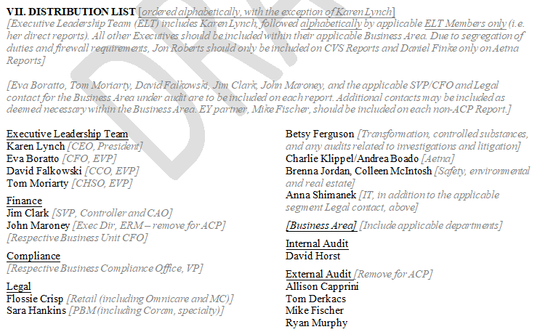
Distribution List – Methodology Current State

Slide 6
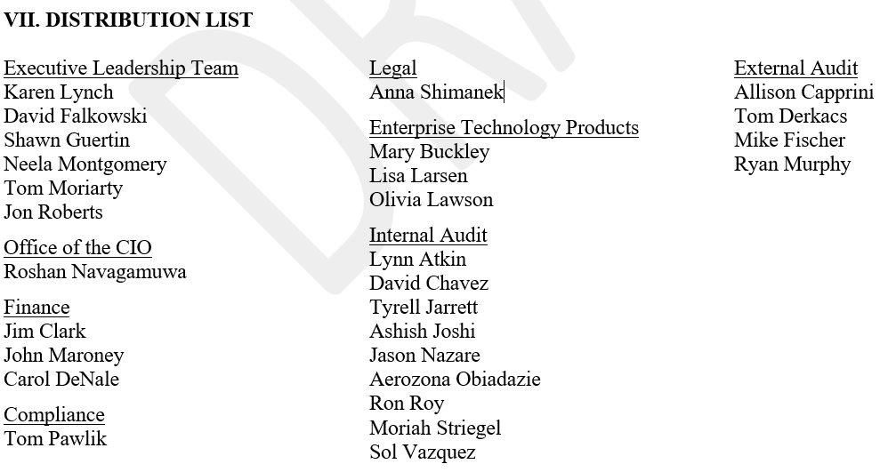
Distribution List – Methodology Current State

Slide 7
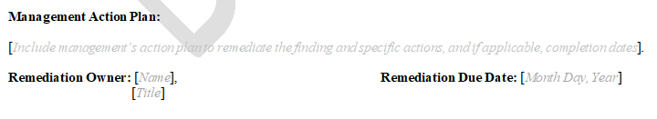
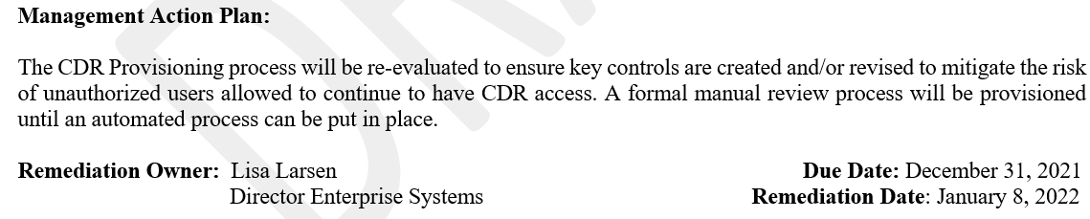
Report Due Dates
Current Template
Revised Until Template Update – Dates Align with AuditBoard Fields

Slide 8
Feedback / Questions

